Slide 1
RESEARCH PROJECT Maze Solving and target searching using Genetic Algorithm
Prajjwal Chittori (2K18/CO/249)
Pawan Kumar (2K18/CO/245)
Dept. of Computer Science and Engineering)

Slide 2
Agenda
To study and understand Genetic Algorithm and its applications .
We will use GA for finding the best path for a mobile robot in a 2D environment.
We will simulate steps to move from starting point to the endpoint while avoiding collisions with obstacles and minimizing total distance travelled.
We will attempt to understand how and where the concepts of Maze Solving using GA can be implemented to solve real world problems.
Keyword -GA (Genetic Algorithm)

Slide 3
Genetic Algorithm
A genetic algorithm is a search heuristic that is inspired by Charles Darwin’s theory of natural evolution. This algorithm reflects the process of natural selection where the fittest individuals are selected for reproduction in order to produce offspring of the next generation.Some examples of GA applications include optimizing decision trees for better performance, automatically solve sudoku puzzles,hyperparameter optimization using GGA.
Keyword - GGA (Grouping genetic algorithm)

Slide 4
Genetic Algorithm
The process of natural selection starts with the selection of fittest individuals from a population. They produce offspring which inherit the characteristics of the parents and will be added to the next generation. If parents have better fitness, their offspring will be better than parents and have a better chance at surviving. This process keeps on iterating and at the end, a generation with the fittest individuals will be found.

Slide 5
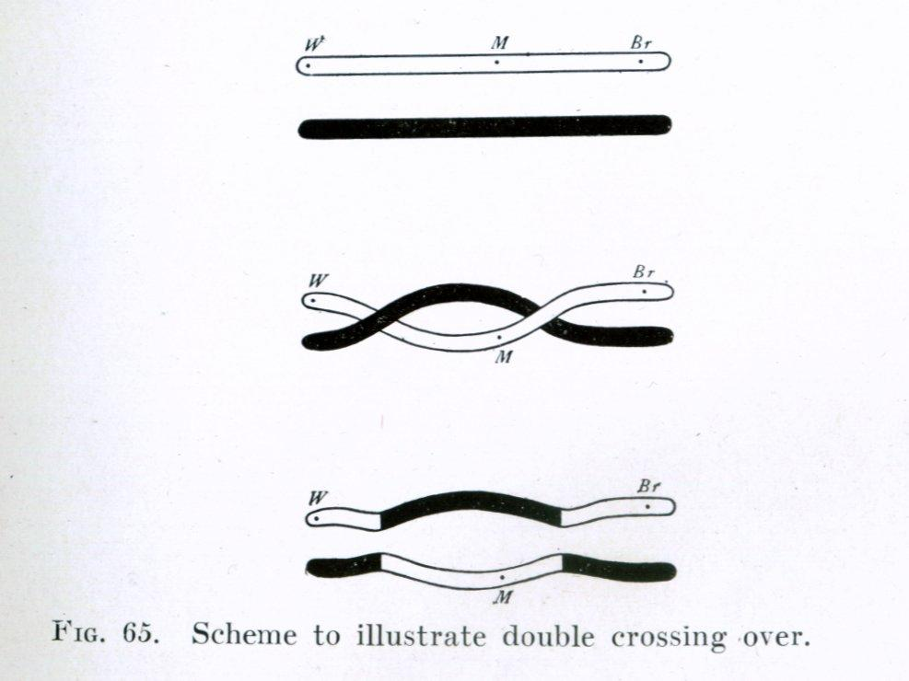


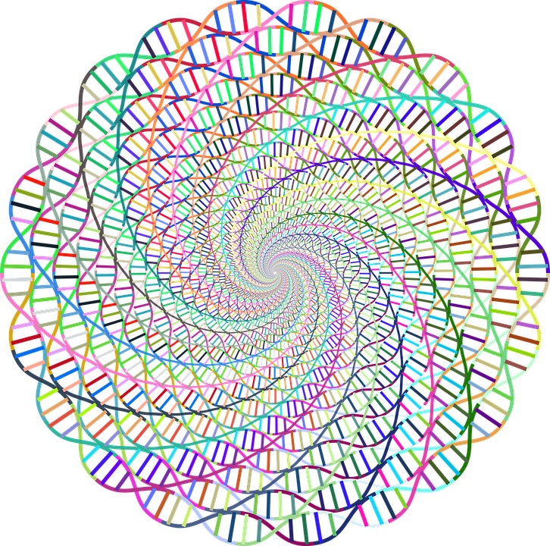
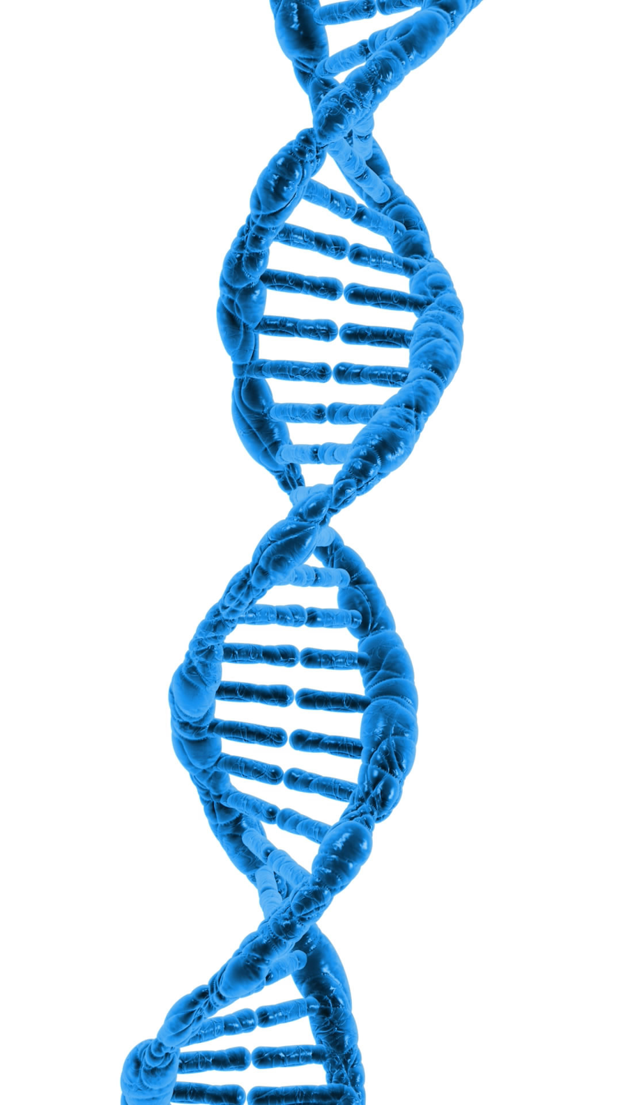
Five Stages in GA
Initial
Population
Fitness
Function
Selection
Crossover
Mutation

Slide 6
Five Phases
Initial population
The process begins with a set of individuals which is called a Population. Each individual is a solution to the problem you want to solve.
The set of genes of an individual is represented using a string, in terms of an alphabet
Fitness Function
The fitness function determines how fit an individual is (the ability of an individual to compete with other individuals). It gives a fitness score to each individual. The probability that an individual will be selected for reproduction is based on its fitness score.
Selection
The idea of selection phase is to select the fittest individuals and let them pass their genes to the next generation.
Two pairs of individuals (parents) are selected based on their fitness scores. Individuals with high fitness have more chance to be selected for reproduction.

Slide 7
Five Phases
Crossover
Crossover is the most significant phase in a genetic algorithm. For each pair of parents to be mated, a crossover point is chosen at random from within the genes.Offspring are created by exchanging the genes of parents among themselves until the crossover point is reached.
Mutation
In certain new offspring formed, some of their genes can be subjected to a mutation with a low random probability. This implies that some of the bits in the bit string can be flipped.Mutation occurs to maintain diversity within the population and prevent premature convergence.
Termination
The algorithm terminates if the population has converged (does not produce offspring which are significantly different from the previous generation).Then it is said that the genetic algorithm has provided a set of solutions to our problem.

Slide 8
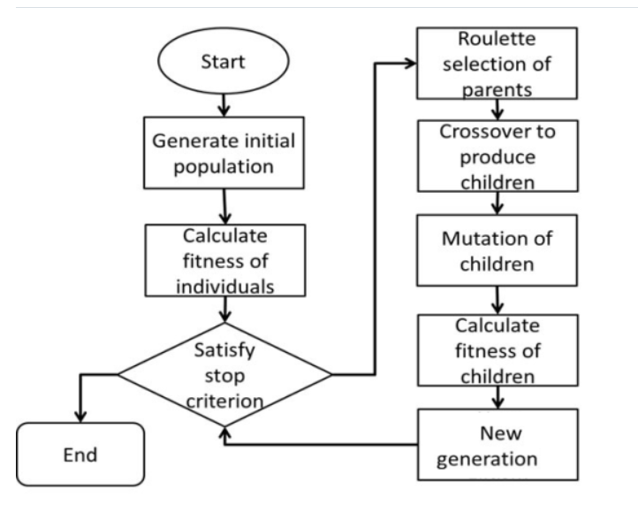
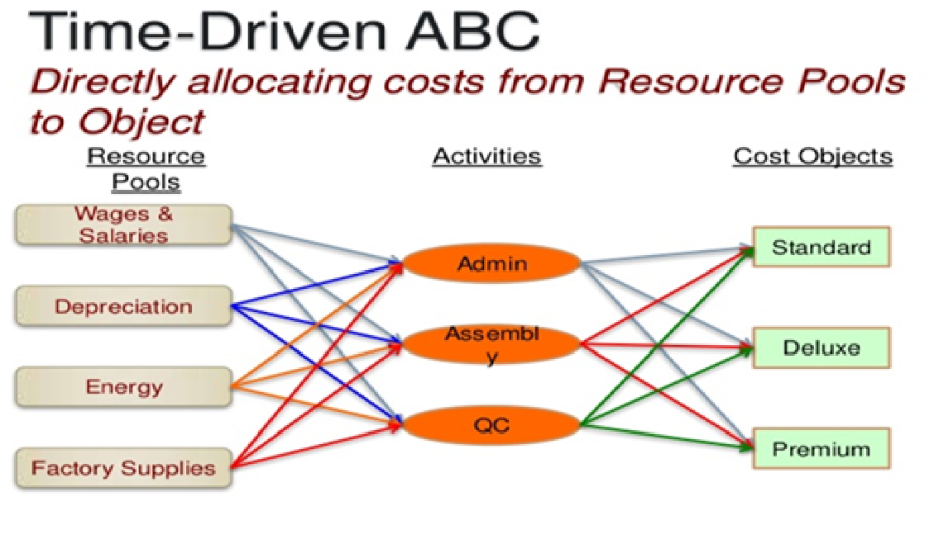

Our Approach
A new GA approach is suggested to solve path planning problems in the 2D environment. The strength of genetic algorithms lies in the cooperative use of different genetic operators (selection, crossover, and mutation).

Slide 9
Our Approach
The choice of genetic operators is a crucial step for the convergence of the genetic algorithm.Thus we tried to improve the classic crossover operator.
In our approach we propose an improved crossover operator that uses parents with good fitness to increase the quality of progeny as well as parents with low fitness value to explore the research space and ensure diversity among the population.
This operator also takes into account variable length chromosomes.
The population has a fixed size. As new generations are formed, individuals with least fitness die, providing space for new offspring.
The sequence of phases is repeated to produce individuals in each new generation which are better than the previous generation.

Slide 10
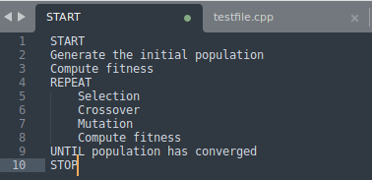
Pseudo-Code
A population (swarm) of candidate solutions (particles) moves in the search space, and the movement of the particles is influenced both by their own best known position and swarm's global best known position

Slide 11
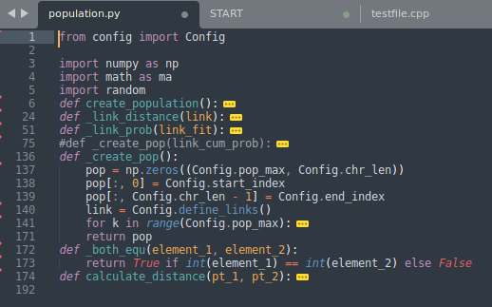
population.py

Slide 12
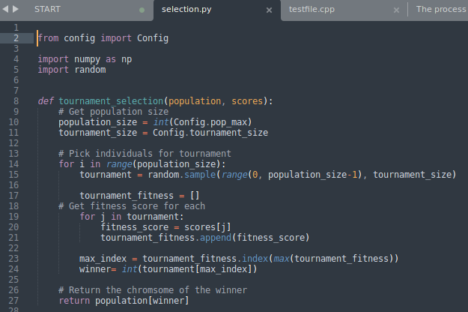
selection.py

Slide 13
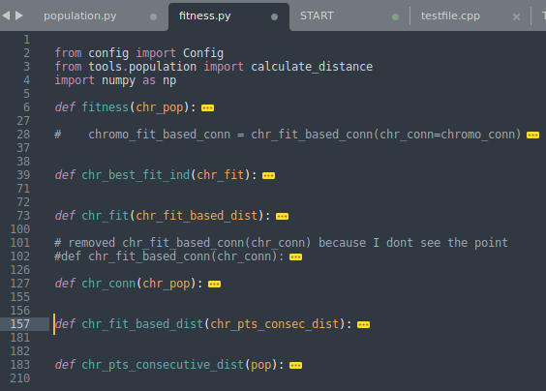
fitness.py

Slide 14
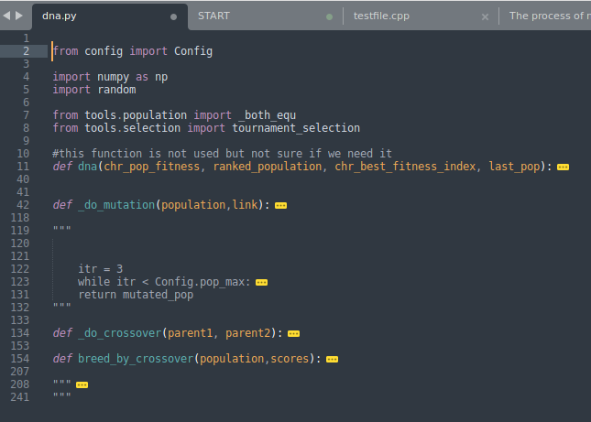
dna.py

Slide 15
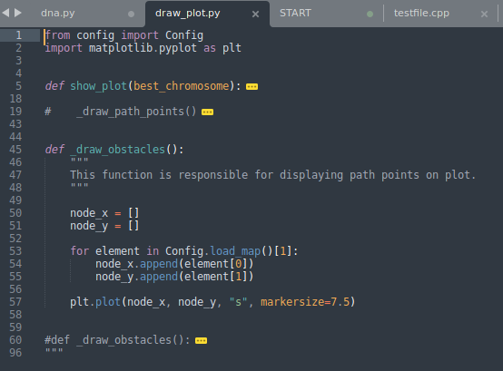
draw_plot.py

Slide 16
Work Through of Our Implementation
Draw_plot.py generates maze and draws steps on screen
fitness.py calculates fitness
Crossover and Mutation applied by dna.py
1
3
5
2
4
6
population.py generates population
selection.py selects fittest
repeat the process until solution found

Slide 17
Things to take care of
Crossover rate should be 80%-95%
Mutation rate should be low i.e. 0.5%-1% assumed as best
The method of selection should be appropriate
Writing of fitness function must be accurate
They cannot always find the exact solution but they always find the best solution.

Slide 18
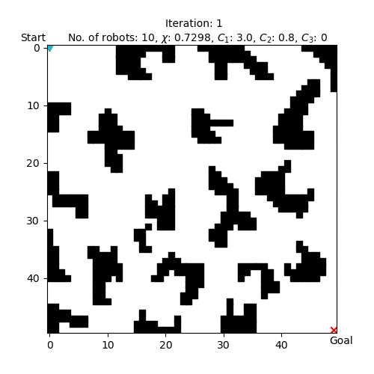
Visualization of the GA

Slide 19
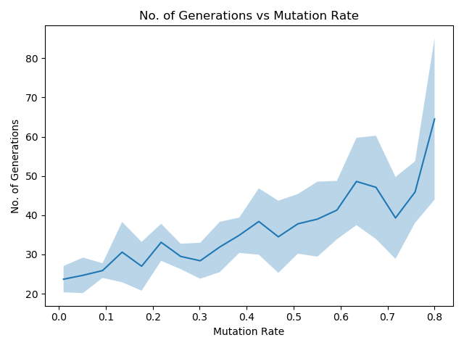
Graph Plot
Number of generations vs Mutation Rate

Slide 20
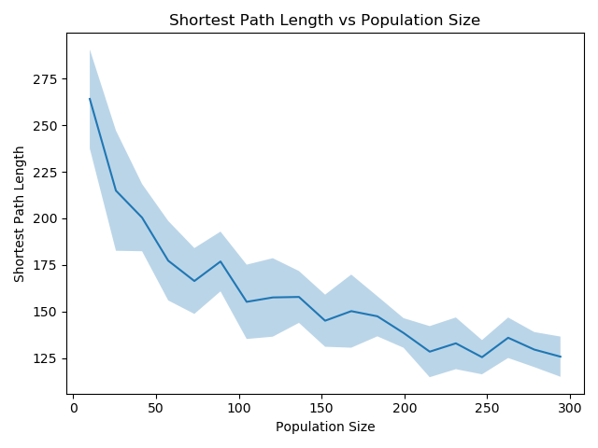
Graph Plot
Shortest Path Length vs Population Size

Slide 21
SWOT ANALYSIS
STRENGTHS
Concepts are easy to understand.Answer gets better with time.Chances of getting optimal solution are more
WEAKNESSES
GAs are very slow. Cannot find always the best solutions
S
W
Genetic Algorithms are intrinsically parallel. Time reduction possible and easily distributed
OPPORTUNITIES
The population considered for the evolution should be moderate or suitable one for the problem
THREATS
O
T

Slide 22
APPLICATIONS
Mathematical Problems
Chess Analysis
Game Theory
Financial Problems

Slide 23

THANKS!

